Slide 1


Debouncing in React
Debouncing is a technique used to optimize performance by limiting the frequency of a function's execution. It helps reduce unnecessary operations, improve user experience, and enhance the responsiveness of web applications. Debouncing is particularly valuable for scenarios involving user input, API calls, and event handling, ensuring smooth and efficient execution.

Slide 2
Why Do We Need Debouncing?
Frequent Calls
Performance Bottleneck
Solution: Debouncing
Consider a scenario where you have an API call triggered for every keystroke in a search input field. This can lead to a flurry of requests, overloading the server and causing delays in response times.
The constant API calls create a performance bottleneck, resulting in a sluggish user experience. The application may feel slow and unresponsive, frustrating users.
Debouncing helps solve this problem by limiting the rate at which the API call function is executed. It ensures that the function is called only after a certain delay, allowing for more efficient use of resources.

Slide 3


What is Debouncing?
1
Delayed Execution
2
Control Frequency
3
Throttling
Debouncing delays the execution of a function until a certain period of inactivity has passed. This means that if the function is called multiple times within the delay period, only the last call will be executed.
Debouncing effectively controls the frequency of function execution, preventing it from being called too often and reducing the strain on system resources.
Throttling, a related technique, limits the rate at which a function can be called, allowing a maximum number of executions within a specified time interval.

Slide 4


Implementing Debouncing in React
1
setTimeout
The setTimeout function in JavaScript allows you to delay the execution of a function by a specified amount of time.
2
clearTimeout
The clearTimeout function cancels a pending setTimeout call, preventing the delayed execution if a new input event occurs within the delay period.
3
Basic Setup
The basic debouncing setup in React involves using a state variable to store the timeout ID and using the useEffect hook to handle the debouncing logic.

Slide 5


Debouncing in Action
Pin-Code Search
A simple React application that uses debouncing to search for pin codes. The application fetches data from an API based on the user's input, but only after a short delay.
Functionality
The user enters a pin code, and the application triggers an API call to retrieve information related to the entered code. However, the call is only executed after a delay, preventing unnecessary calls.
Code Snippets
The application utilizes React hooks, including useState for managing the input value, useEffect for handling the debouncing logic, and a custom API call function to retrieve data.

Slide 6


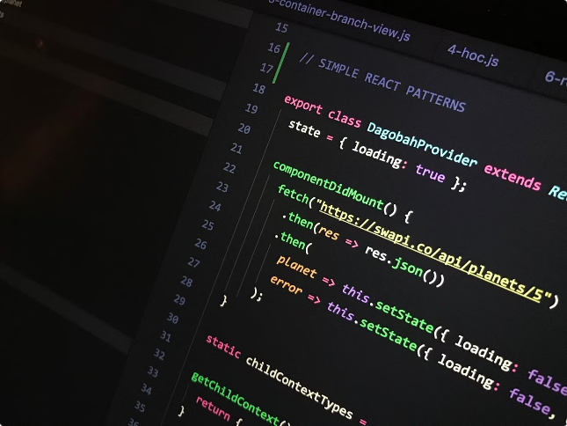


Code Walkthrough
useEffect Hook
The useEffect hook is used to track changes in the input value and trigger the debouncing logic.
setTimeout
A setTimeout is set to delay the API call. The delay value determines the inactivity period before the call is executed.
clearTimeout
If the user continues to type within the delay period, clearTimeout is used to cancel the previous timeout, preventing an outdated API call.

Slide 7




Live Demo
User Interaction
The demo shows how typing in the search input triggers a debounced API call. This results in a smooth and responsive user experience.
Performance Impact
The demo highlights the impact of debouncing on performance. The application remains responsive even with frequent user input.

Slide 8

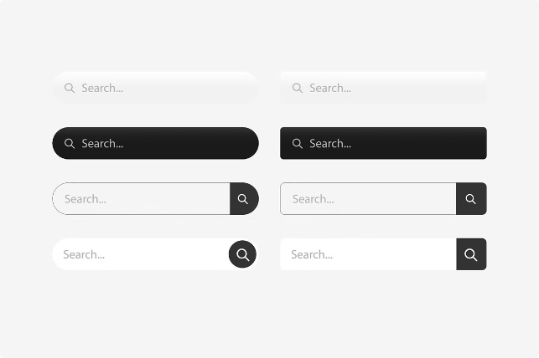
Applications of Debouncing
Form Submissions
Preventing multiple submissions when a user clicks the submit button repeatedly.
Button Clicks
Ensuring that a function is called only once even if a button is clicked multiple times within a short period.
Search Bars
Improving the responsiveness of search functionalities by delaying API calls until the user pauses their typing.

